Slide 1
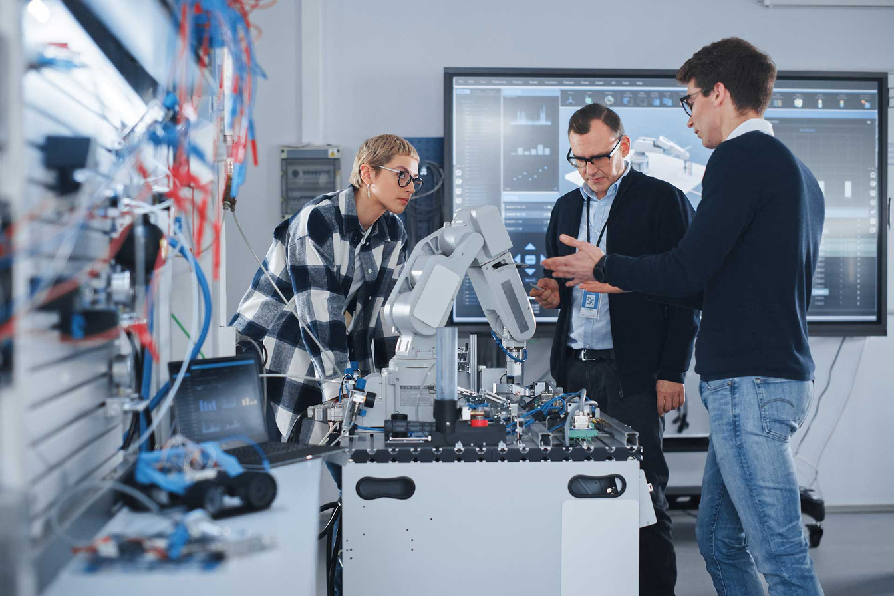


AI- Based Training an Assessment Tool For Vocational Education
24-25J-185

Slide 2




OUR TEAM
Vilajini.Y
IT2118928
Saseena M.U.F
IT21188954
Sujeevan.R
IT20657314
Niles A.P
IT21347726
Vilajini.Y, Saseena M.U.F, Sujeevan.R,
Niles A.P

Slide 3

Introduction
Background
Research Problem
Objective
Overall System Diagram

Slide 4
AI offers scalable, personalized, and engaging solutions.
Enhances assessment and feedback processes.
Modernizes vocational training to align with industry demands
Background
Difficult to expand traditional training methods.
Significant time and resources required for managing vocational training.

Slide 5
Traditional vocational training methods follow a one-size-fits-all approach, failing to meet individual student needs
Students often lose interest in vocational training due to the lack of interactive and immersive learning experiences.
Research Problems
Traditional assessment methods are slow, leading to delayed feedback that impacts student learning and skill development.
Vocational training programs often fail to keep up with rapidly changing industry demands, leading to outdated skillsets.

Slide 6
Develop an AI-based training and assessment tool that transforms vocational education by providing personalized learning experiences, automating assessments with real-time feedback, and enhancing student engagement through gamification and interactive learning modules.
Main Objective

Slide 7
Intelligent Tutor and Automated Assessment System with AI-Viva Session
AI powered Virtual mentor and Support System
Sub Objectives
Skill-Based Adaptive and Personalized Learning Path Component
Gamification and Game-Based Learning for Vocational Education

Slide 8
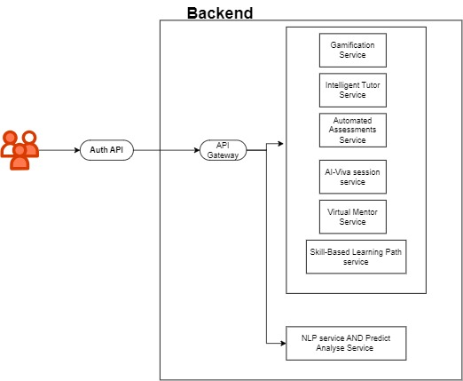
Overall System Diagram
IT21189258 | Vilajini.Y | 24-25J-185

Slide 9
Intelligent Tutor and Automated Assessment System with AI-Viva Session
It21189258
Vilajini.Y
Information Technology
IT21189258 | Vilajini.Y | 24-25J-185

Slide 10
Background
Research Question
Introduction
Research Gap
Objectives
Methodology
IT21189258 | Vilajini.Y | 24-25J-185

Slide 11
Background
AI-driven viva sessions simulate real-world interview scenarios.
Provides comprehensive assessments beyond written exams.
Intelligent tutoring systems can adapt to individual learning styles.
Traditional assessment methods are manual and time-consuming.
IT21189258 | Vilajini.Y | 24-25J-185

Slide 12
Research Question
How can AI-driven intelligent tutoring systems and automated assessments, including AI-Viva sessions, be developed to provide personalized, real-time feedback and simulate realistic oral exams in vocational education?
IT21189258 | Vilajini.Y | 24-25J-185

Slide 13


Research Gap
Features | Traditional ITS | AI-Driven Assessment Systems | Proposed System
AI-Driven Viva Simulations
Comprehensive NLP for Assessment
Context-Aware Adaptive Learning
IT21189258 | Vilajini.Y | 24-25J-185

Slide 14
System Diagram
Methodology
Tools and Technologies
Requirements
IT21189258 | Vilajini.Y | 24-25J-185

Slide 15
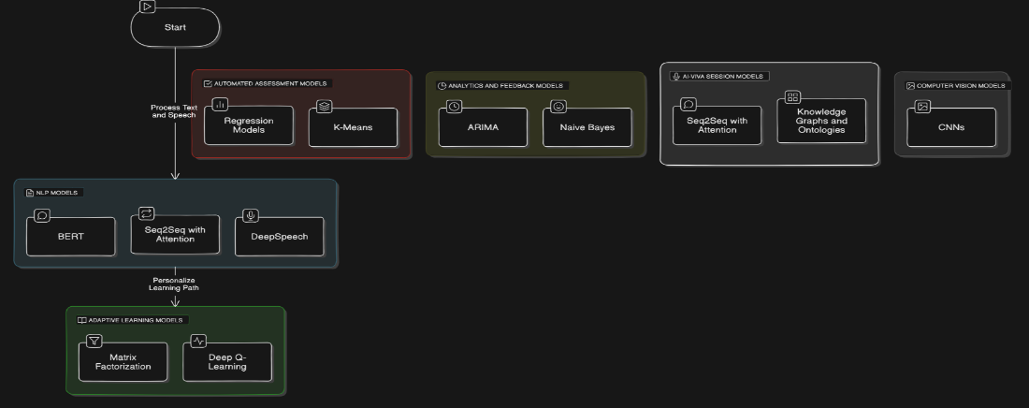
System Diagram
IT21189258 | Vilajini.Y | 24-25J-185

Slide 16


Tools and Technologies
Python
React Js
Django
PostgreSQL
Google Cloud Speech-To-Text-API
ChatGPT API for AI-Chatbot
IT21189258 | Vilajini.Y | 24-25J-185

Slide 17
Requirements
Functional Requirements
NON-Functional Requirements
User Authentication
AI-Viva Session
Performance Analytics
Content Management
Communication Module
Integration with External Systems
Security
Performance
Reliability
Scalability
Usability
Maintainability
Compatibility
Accessibility
Localization
Data Backup and Recovery
IT21189258 | Vilajini.Y | 24-25J-185

Slide 18
References
Chassignol, M., Khoroshavin, A., Klimova, A., & Bilyatdinova, A. (2018). Artificial intelligence trends in education: A narrative overview. Procedia Computer Science, 136, 16-24.
Huang, G.-B., Zhu, Q.-Y., & Siew, C.-K. (2006). Extreme learning machine: theory and applications. Neurocomputing, 70(1-3), 489-501.
Jean-Charles, A. (2018). Internet of things in education: Artificial intelligence voice assistant in the classroom. Society for Information Technology & Teacher Education International Conference, 883-885.
Patrick, S., Kennedy, K., & Powell, A. (2013). Mean what you say: Defining and integrating personalized, blended and competency education. International Association for K-12 Online Learning.
IT21189258 | Vilajini.Y | 24-25J-185

Slide 19

AI powered Virtual mentor and Support System
It21188954
Saseena M.U.F
Information Technology
IT21188954 | Saseena M.U.F | 24-25J-185

Slide 20
Background
Introduction
Research Question
Research Gap
Objectives
Methodology
IT21188954 | Saseena M.U.F | 24-25J-185

Slide 21

Background
Utilize AI to create a virtual mentor for vocational education
Provide personalized support and guidance to students.
Facilitate continuous improvement and skill development.
IT21188954 | Saseena M.U.F | 24-25J-185

Slide 22

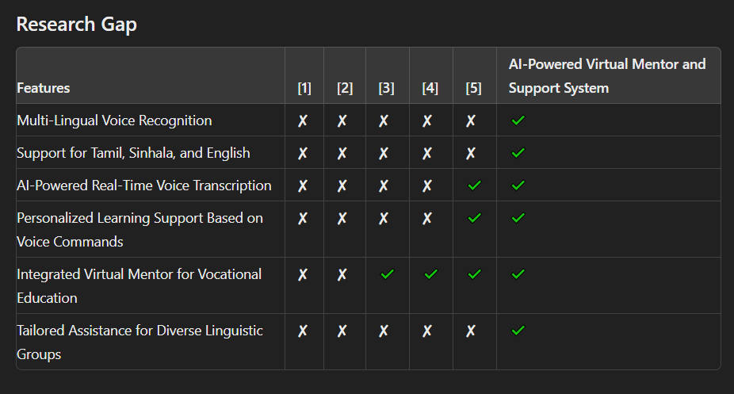
Research Gap
Novelty
Multi-Lingual Voice Recognition
IT21188954 | Saseena M.U.F | 24-25J-185

Slide 23

Research Question
What are the challenges of integrating AI into vocational curricula?
How can AI-powered virtual mentors revolutionize vocational education?
How can AI mentors facilitate continuous skill development?
What are the challenges and solutions in implementing accurate multilingual voice recognition for Tamil, Sinhala, and English in AI-powered virtual mentors for vocational education?
How does the integration of multilingual voice recognition in AI chatbots enhance the learning experience and outcomes in vocational education settings?
IT21188954 | Saseena M.U.F | 24-25J-185

Slide 24

Objective
Main Objective
To develop an AI-powered virtual mentor and support system that enhances vocational education through multi-lingual voice recognition, enabling effective and personalized learning experiences for Tamil, Sinhala, and English-speaking users.
Sub Objective
Develop an AI chatbot for voice-controlled interaction.
Integrate a multilingual speech recognition service.
Implement ASR for Tamil, Sinhala, and English transcription.
Design a user-friendly interface for recording voice notes.
Incorporate a microphone button for easy recording control.
IT21188954 | Saseena M.U.F | 24-25J-185

Slide 25

Methodology
Study Design
Outline the framework for the AI mentor system in vocational education.
Data Collection
Gather relevant educational data for training the AI system
Data Preprocessing
Clean and prepare data for model training.
Model Development
Select and design AI models tailored to the system’s needs.
Training & Evaluation
Train models and evaluate performance using key metrics
IT21188954 | Saseena M.U.F | 24-25J-185

Slide 26
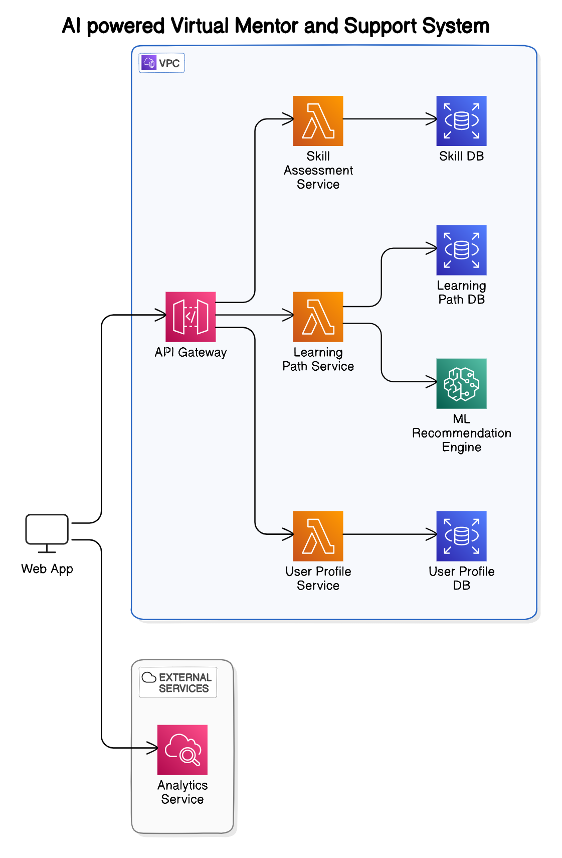
System Diagram
IT21188954 | Saseena M.U.F | 24-25J-185

Slide 27

Component Specific Requirements
Functional requirements
Non-functional requirements
Develop Multi-lingual chatbot in Tamil, Sinhala, and English.
Provides mentorship across various vocational subjects.
Supports Tamil, Sinhala, and English with diverse accent handling.
Accurate transcription of spoken input.
Performance:
Usability
Scalability
Security
Responsive recording control with automatic save and processing.
Seamless access to sessions and notes, with export functionality.
Reliability
IT21188954 | Saseena M.U.F | 24-25J-185

Slide 28

Reference
The Application of Artificial Intelligence Technology in Personalized Teaching in Vocational Education
https://doi.org/10.1109/ICAI50792.2020.9317316
Exploring AI-enabled Intelligent Tutoring System in Vocational Education
https://doi.org/10.1109/TALE.2019.8981689
The Role of AI In Vocational Education: A Systematic Review
https://www.magnascientiapub.com/ai-vocational-education
AI's Impact on Vocational Training and Employability: Innovation, Challenges, and Perspectives
https://doi.org/10.36948/ijfmr.2024.v06i04.24967
Designing an AI-Powered Mentorship Platform for Professional Development
https://doi.org/10.1186/s13634-020-00737-y
IT21188954 | Saseena M.U.F | 24-25J-185

Slide 29

Skill-Based Adaptive and Personalized Learning Path Component
IT20657314
Sujeevan.R
Information Technology
IT20656314 | Sujeevan.R | 24-25J-185

Slide 30
Background
Introduction
Research Question
Research Gap
Objectives
Methodology
IT20656314 | Sujeevan.R | 24-25J-185

Slide 31
Backround
In recent years, personalized learning has become increasingly important, with a focus on adapting educational experiences to meet individual student needs.
Traditional educational systems often struggle to provide tailored learning paths, which can lead to student disengagement and uneven skill development.
AI-driven personalized learning paths can offer real-time adjustments, ensuring that students receive content and challenges appropriate to their skill levels.
IT20656314 | Sujeevan.R | 24-25J-185

Slide 32


Research Question
How can AI-driven systems effectively measure and adapt to a student's skill level in real-time?
What methods can be implemented to dynamically adjust the complexity of learning content?
How can continuous performance monitoring enhance personalized learning experiences?
IT20656314 | Sujeevan.R | 24-25J-185

Slide 33
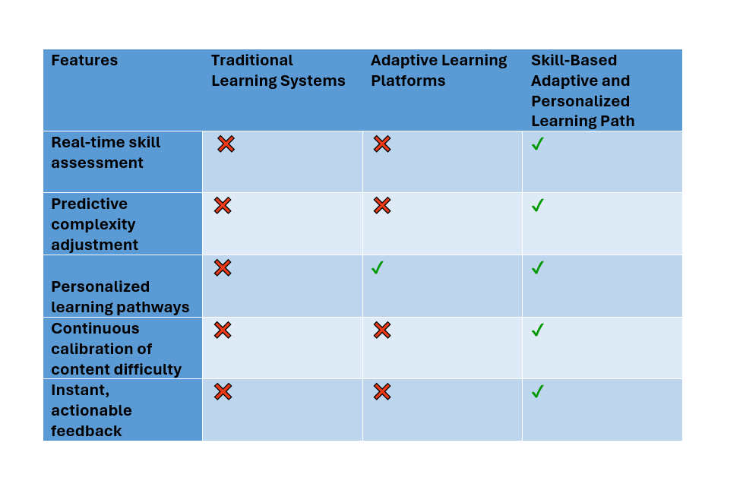
Research Gap
Novelty
Real-time adjustment of learning content complexity based on continuous skill evaluation.
Personalized Pathways: Tailoring learning paths to address individual strengths and weaknesses.
Continuous Calibration: Ongoing assessment and adjustment of learning materials to ensure optimal challenge levels.
IT20656314 | Sujeevan.R | 24-25J-185

Slide 34



Objectives
Main Objectives
Develop a system that enhances student engagement and learning outcomes through adaptive, personalized learning paths.
Sub Objective
Implement real-time skill evaluation mechanisms.
Develop algorithms for predictive complexity adjustment.
Design a system for continuous calibration of learning content.
Integrate instant feedback and actionable learning strategies.
IT20656314 | Sujeevan.R | 24-25J-185

Slide 35
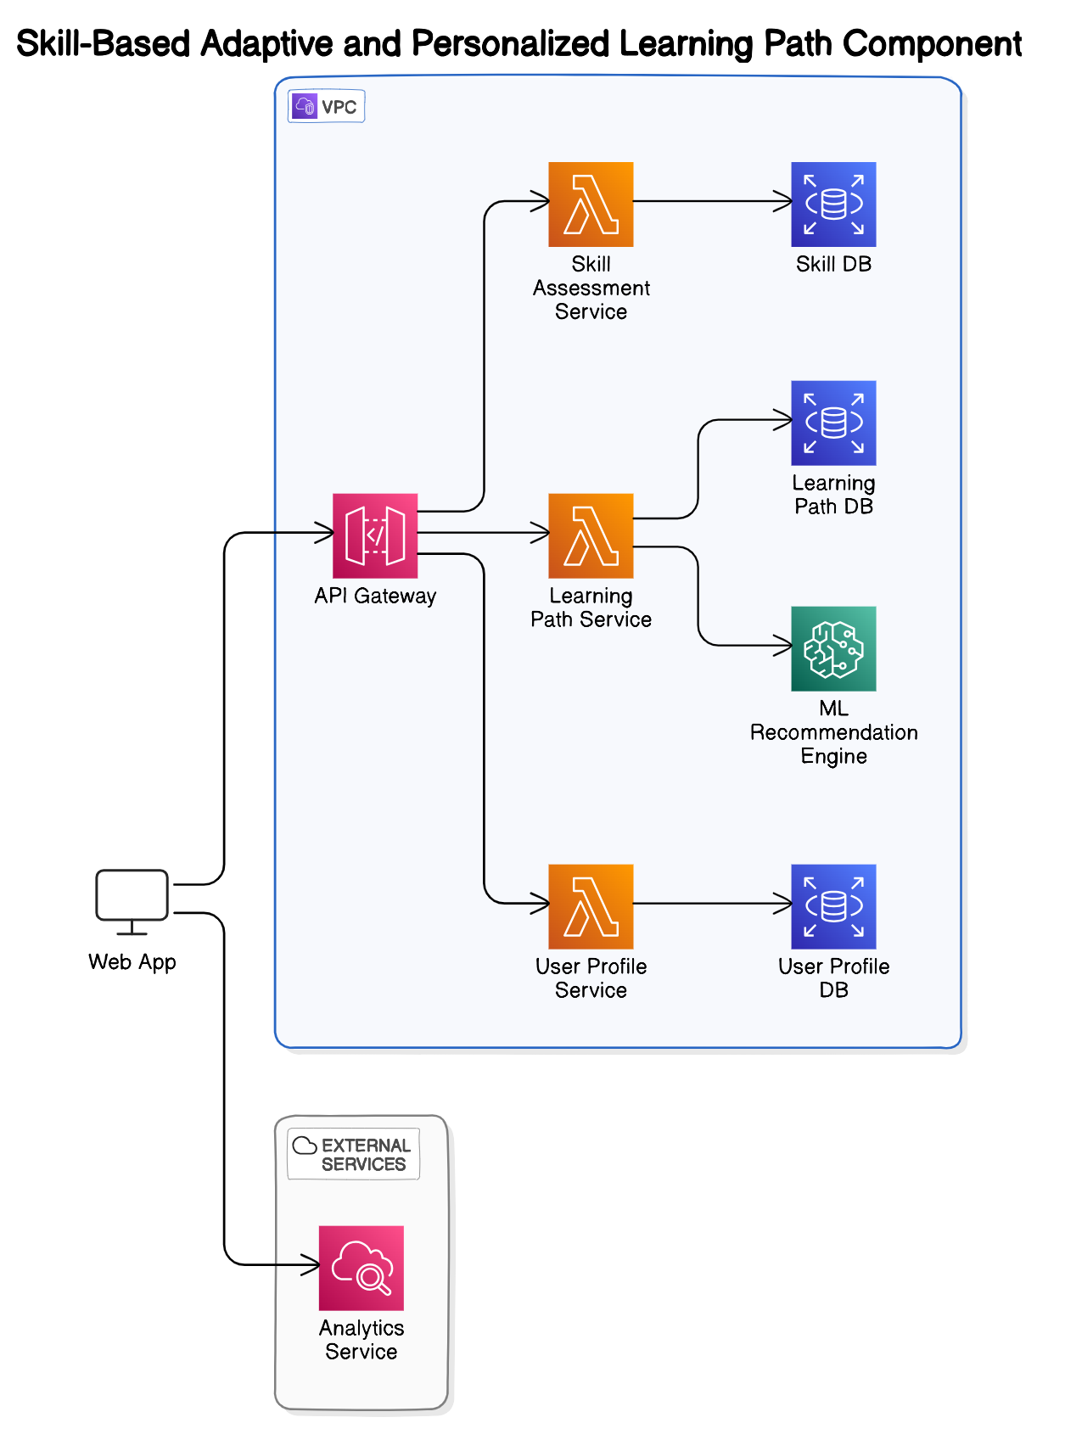
System Diagram
IT20656314 | Sujeevan.R | 24-25J-185

Slide 36
Component Specific Requirements
Functional requirements
Non-functional requirements
Provide personalized learning content based on real-time skill assessment.
Continuously adjust the complexity of tasks and materials.
Offer immediate, actionable feedback to students.
Track and monitor student progress to dynamically adapt learning pathways
Availability
Reliability
Speed
Performance
Security
Privacy
IT20656314 | Sujeevan.R | 24-25J-185

Slide 37
Methodology
Collect student data such as performance scores, course content, and engagement levels.
Clean and prepare the data for training, ensuring it's ready for the AI models.
Choose and build AI models that predict student performance and customize learning paths.
Train the AI models and test their accuracy to ensure they work effectively.
Integrate the AI with the educational platform, making it easy to use for students and teachers.
Allow the AI to adjust the difficulty of tasks based on how students are performing in real-time.
Keep track of student progress, with the AI constantly refining learning paths and materials.
Provide instant feedback to students and suggest ways to improve, using data to enhance the AI.
IT20656314 | Sujeevan.R | 24-25J-185

Slide 38
References
[1]J. Smith, R. Patel, and M. Brown, "AI-Driven Personalized Learning Systems: A Review," in Proc. IEEE Int. Conf. on e-Learning, 2023, pp. 124-129.
[2]A. Gomez, P. Clark, and S. Johnson, "Machine Learning Techniques for Personalized Education," in Proc. IEEE Global Engineering Education Conference (EDUCON), 2023, pp. 678-682.
[3]M. K. Lee and T. Kim, "Personalized Learning in AI-Enhanced Classrooms," in IEEE Transactions on Learning Technologies, vol. 15, no. 3, pp. 788-797, 2023.
IT20656314 | Sujeevan.R | 24-25J-185

Slide 39

Gamification and Game-Based Learning for Vocational Education
IT21347726
Niles A.P
Information Technology
IT21347726 | Niles A.P | 24-25J-185
08/07/24
<number>

Slide 40
Backround
Introduction
Research Question
Research Problems
Objectives
Methodology
IT21347726 | Niles A.P | 24-25J-185

Slide 41
Backround
Why is Gamification and Game-Based Learning for Vocational Education important?
Gamification and Game-Based Learning in vocational education make learning more engaging and effective by integrating interactive elements. This approach enhances skill development, motivation, and real-world application, better preparing students for modern job demands.
IT21347726 | Niles A.P | 24-25J-185

Slide 42
Research Question
How can gamification and game-based learning enhance the effectiveness and engagement of vocational education programs for electricians and automobile engineers?
What are the most effective virtual scenarios for enhancing practical skill development in vocational training for electricians and automobile engineers?
How does the integration of collaborative learning approaches within a game-based environment influence teamwork and communication skills in vocational education?
IT21347726 | Niles A.P | 24-25J-185

Slide 43
Research Problem
Main reasons why Gamification and Game-Based Learning for Vocational Education is important?
Enhanced Engagement: Increases student motivation and active participation in learning activities.
Practical Skill Development: Provides hands-on, risk-free practice of real-world tasks.
Improved Learning Outcomes: Facilitates better retention and understanding of complex concepts.
Personalized Learning: Adapts to individual student needs, allowing for customized learning paths.
IT21347726 | Niles A.P | 24-25J-185

Slide 44
Research Gap
Novelty
•Develop and Implement Gamified Learning Modules
•Design virtual scenarios for Electricians and Auto Mobile engineers
•Implementing Collaborative learning
•Provide a Progress tracking method for learners and instructors
IT21347726 | Niles A.P | 24-25J-185

Slide 45
Objectives
Main Objectives
Develop and implement gamified learning modules tailored for vocational education, incorporating virtual scenarios that address the specific training needs of electricians and automobile engineers. Integrate collaborative learning approaches within the game-based environment and establish a robust progress tracking system for both learners and instructors.
Sub Objective
Identify and gamify key concepts in electrical systems and automotive mechanics.
Develop interactive modules with quizzes and games.
Create and refine realistic virtual scenarios for electricians and auto engineers.
Design team-based challenges and a platform for collaboration.
Implement a tracking system with analytics for monitoring progress and effectiveness.
IT21347726 | Niles A.P | 24-25J-185

Slide 46
Methodology
1. Design Phase:
Conduct a needs analysis to identify the key learning outcomes for electricians and automobile engineers.
Collaborate with subject matter experts to ensure the accuracy and relevance of the content.
Design the game elements (avatars, points, badges, leaderboards) and interactive modules.
2. Development Phase:
Develop the gamified learning modules using educational technology platforms.
Create virtual scenarios using simulation software.
Develop collaborative learning activities and integrate them into the platform.
3. Implementation Phase:
Pilot the gamified learning modules with a small group of vocational students.
Gather feedback and make necessary adjustments.
Roll out the modules to a larger audience.
4. Evaluation Phase:
Use progress tracking methods to monitor learner engagement and performance.
Conduct surveys and interviews to gather qualitative data on learner experiences.
Analyze the data to assess the effectiveness of the gamified learning approach.
IT21347726 | Niles A.P | 24-25J-185

Slide 47
Project Requirements
Functional requirements
Non-functional requirements
Provide gamified modules with quizzes and puzzles for electrical and automotive skills.
Enable realistic virtual scenarios simulating industry challenges.
Support team-based challenges and learner communication.
Track progress, offer real-time feedback, and generate performance reports.
Scalability
Usability
Performance
Security
Reliability
Compatibility
IT21347726 | Niles A.P | 24-25J-185

Slide 48
Commercialization
Market Research: Target vocational schools and industries needing electrician and automotive training tools.
Product Development: Build and offer customizable gamified learning modules and virtual scenarios.
Partnerships: Collaborate with educational institutions for pilot testing and industry endorsements.
Marketing & Sales: Use demonstrations, freemium models, and targeted advertising to reach potential clients.
Support & Expansion: Provide training and ongoing support, collect feedback, and expand into other vocational fields.
Revenue Model: Implement subscription-based pricing and offer certification programs for added value.
IT21347726 | Niles A.P | 24-25J-185

Slide 49



Tools and Technologies
C#
Python
Django
PostgreSQL
React
Github for version control
IT21347726 | Niles A.P | 24-25J-185

Slide 50
References
[1] T. H. Hsu, K. H. Lin, and Y. C. Kuo, "Gamification for Vocational Education: An Empirical Study of a Gamified Learning System," IEEE Access, vol. 8, pp. 88910-88922, 2020. DOI: 10.1109/ACCESS.2020.2995947.
[2] M. Al-Ali, H. S. Al-Omari, and F. A. Al-Debei, "The Impact of Game-Based Learning on Vocational Training: A Case Study," IEEE Transactions on Education, vol. 62, no. 3, pp. 154-161, Aug. 2019. DOI: 10.1109/TE.2019.2915110.
[3] Y. G. Li, Y. H. Chen, and J. J. Huang, "Design and Evaluation of a Gamified Learning Platform for Vocational Training," IEEE Transactions on Learning Technologies, vol. 12, no. 1, pp. 60-69, Jan.-Mar. 2019. DOI: 10.1109/TLT.2018.2879476.
[4] L. H. Yang, J. C. Chen, and M. K. Tsai, "Integrating Gamification into Vocational Education: A Study on Learning Outcomes and Engagement," IEEE Transactions on Education, vol. 65, no. 4, pp. 381-388, Nov. 2022. DOI: 10.1109/TE.2022.3165629.
IT21347726 | Niles A.P | 24-25J-185

Slide 51
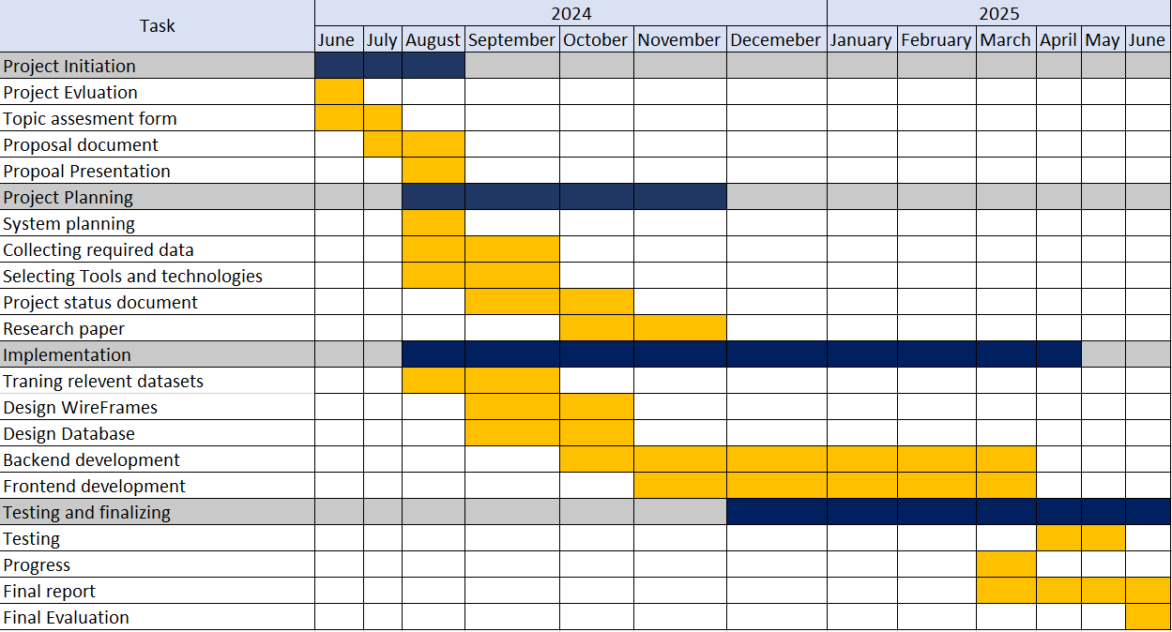
Gantt Chart
IT21347726 | Niles A.P | 24-25J-185

Slide 52


